Slide 1
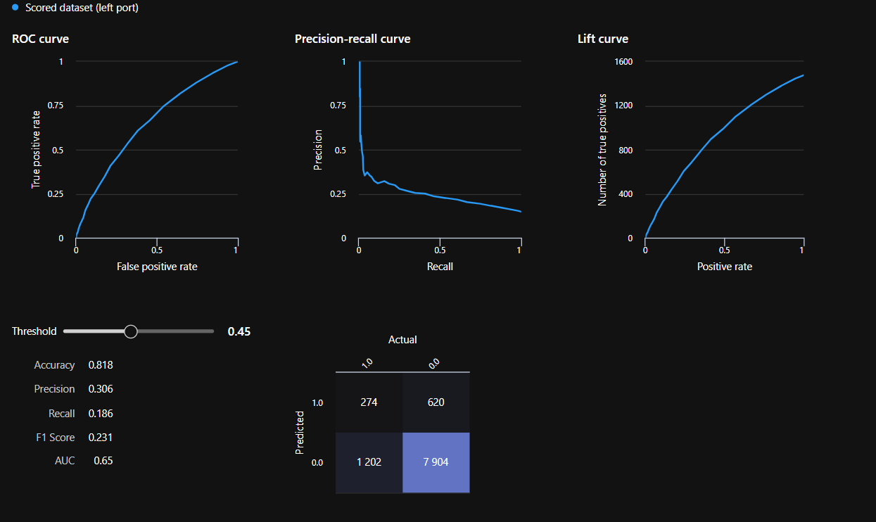
Predictive modelling for customer booking.
Our model is capable of yielding predictions
with an accuracy over 81% given the
precision is over 31% and recall over 23%.
This is due to the class imbalance which is
then treated using SMOTE analysis.

Slide 2
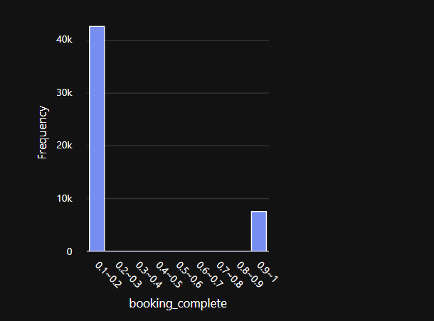
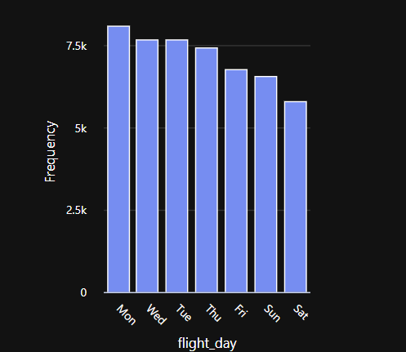


Predictive modelling for customer booking.
It is clearly seen that the number of customers in the given dataset who has done the booking were highly less in number than those who had not done in booking.
This shows high class imbalance.
It can be inferred that the customers are more likely to fly
on Monday than Saturday!! This shows the customers planning to
travel on Monday are more likely to have a booking.
These are top 11 features that are highly influential in yielding better prediction results.

